Slide 1
Neural Network &Deep Learning Journal
Securing the Internet of Vehicles: A Deep Learning-Based
Classification Framework
Srinidhi radharapu
700757822

Slide 2
Motivation
The INTERNET of Vehicles (IoV) is a new paradigm of vehicular networks inspired by the adoption of the Internet of Things (IoT) in Vehicular Ad-hoc Networks (VANETs). IoV is expected to usher in an era of connected vehicles, which use their On-Board Units (OBUs) to communicate with each other and with the road-side infrastructure generally called Roadside Units (RSUs).

Slide 3
Motivation
Nevertheless, the growing number of Vehicle to Vehicle (V2V) and Vehicle to Infrastructure (V2I) communication links in these next-generation vehicular networks also increases the potential attack surfaces in the networks.
And with the increasing number of attack surfaces, there is a higher possibility of cybersecurity attacks. Thus, there is a greater need for developing security solutions for these next-generation vehicular networks such as IoV networks

Slide 4
Problem Statement
Traditional solutions such as cryptography-based authentication techniques have been extensively proposed in.
The existing literature. However, more robust solutions for identifying misbehaving and malicious vehicles are needed. Some intrusion identification and detection techniques inspired by artificial intelligence have been proposed in the literature

Slide 5
Problem Statement
This letter combines the concepts of deep learning and edge computing with vehicular networks.
A deep learning framework for securing the IoV networks backed by edge computing devices.
It presents two classification approaches inspired by deep learning techniques for classifying the misbehaving vehicles in the network.
It demonstrates the performance of both the approaches by simulating various deep learning models for both the classification approaches.

Slide 6
Objectives
Classification Approaches
Coarse-Grained Classification Method: This approach is a two-class coarse-grained classification method (CGCM) that distinguishes normal vehicle data from misbehavior data. In this approach, the faults and attacks are grouped into a single misbehavior (Faults + Attacks) class. When the input data is passed through the CGCM classifier, every possible fault and attack type data is classified into the misbehavior class, while the normal vehicle data is classified into the normal class.

Slide 7
Objectives
Fine-Grained Classification Method: The second approach is a fine-grained classification method (FGCM) with three predicted classes based on normal vehicle behavior, faulty behavior, or attack behavior. Thus, compared to the first approach this is a more fine-grained classification approach. When the input data is passed through the FGCM classifier, normal vehicle data is classified into normal class, the fault type data into the fault class and the attack type data into the attack class.

Slide 8
Objectives
Deep Learning Models :
Two types of deep neural networks called Long Short-term Memory (LSTM) and CNN are considered in this letter which are the building blocks for the deep learning models which go into the proposed classifiers.
LSTMs are a type of Recurrent Neural Networks (RNNs) which are found to be quite efficient in classifying time series data due to the feedback loops present in their architecture that can remember temporal data. Thus, they find their applications in temporal sequence classification problems such as intrusion detection and speech recognition.

Slide 9
Objectives
CNNs are another type of deep neural networks which work best on visual images. Using an architecture of sliding filters and convolutional input layers, they can identify complex patterns in the input data

Slide 10
Contributions
Four different models based on these two architectures are used here.
The CNN-LSTM model (Model 1) considered consists of two 1D CNN layers with 1024 and 512 filters each, followed by a max-pooling layer, an LSTM layer of 512 units, and an output dense layer of 1 unit. The CNN and dense layers are activated by rectified linear unit (ReLU) activation functions.
Three different stacked LSTM models are considered in this letter, namely, 3-LSTM model (Model 2) with three stacked LSTM layers, 4-LSTM model (Model 3) with four stacked LSTM layers, and 5-LSTM model (Model 4) with five stacked LSTM layers, followed by a single neuron output dense layer which is activated by a ReLU activation function.
Each LSTM layer in the stacked LSTM models consists of 256 units. The final LSTM layer in the stacked LSTM models has its return sequences parameter set to false

Slide 11
.
Dataset
The popular VeReMi Extension dataset [12] in this research. It covers several misbehaviour types including both faulty transmissions (henceforth called faults), and cybersecurity attacks (henceforth called attacks).
Faults in this dataset pertain to incorrect position and velocity values. There is data corresponding to eight such faults in this dataset namely constant position/velocity, constant position/velocity offset, random position/velocity, and random position/velocity offset.
The dataset also consists of the following nine attacks namely Denial of Service (DoS), data replay, disruptive, DoS random, DoS disruptive, data replay sybil, traffic congestion sybil, DoS random sybil, and DoS disruptive sybil.

Slide 12
-
Training and Testing
Keras, a Python library for deep learning was used for the development of the models, and all the experimental training was carried out on the Google Collaboratory environment [14]. Adam optimizer with a learning rate of 0.0003 was used.

Slide 13
.
Evaluation
In this section, both the classifiers are evaluated in terms of the four popular evaluation metrics after passing the test dataset through these classifiers.
The four metrics accuracy, precision, recall, and F1-score denoted by A,P, R, F1 respectively are defined below.
Here T P, T N , FP, FN refer to True Positive, True Negative, False Positive, and False Negative, respectively. A = T P + T N T P + FP + T N + FN (2) P = T P T P + FP (3) R = T P T P + FN (4) F1 = 2PR P + R

Slide 14
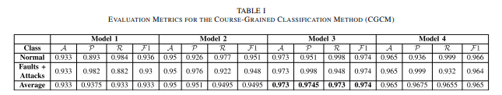
Results

Slide 15
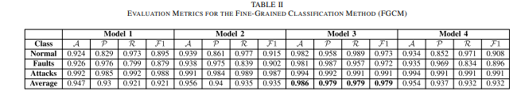
Results

Slide 16
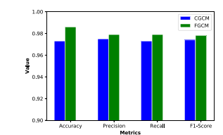
.

Slide 17
Conclusion
This letter proposed deep learning-based classification approaches for identifying and classifying misbehaving vehicles in the IoV networks. Two classification approaches were considered where one is a coarse-grained classification of normal vehicle data and all possible misbehavior types, the other is a more fine-grained classification to classify the misbehavior.

